Slide 1


August 2025
AI agents for oral assessment
Research findings and ideas for the future
Welcome – we will start in coming minutes.

Slide 2
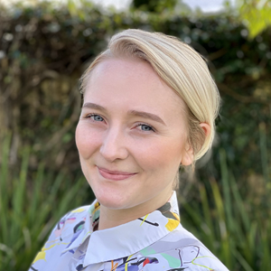



Today’s agenda
4
5
6
Intro
& admin
7 mins
AI agents in
Oceania
7 mins
Demo and mechanics
14 mins
Pilot
findings
8 mins
Q&A
Panel
14 mins
Thanks
& closing
2 mins

Slide 3
Chat and questions
Chat to one another here
React here
Submit panel questions here

Slide 4

Who is in our webinar today?
Warm up

Slide 5
Introduction to the Food and Fibre CoVE
Food and Fibre CoVE plays a pivotal role in strengthening Vocational Education and Training across Aotearoa New Zealand’s food and fibre ecosystem. Their work is centred on:
Transforming skill development through targeted investment and innovation
Driving research and collaboration to shape future-focused education and employment pathways
Delivering impact, with 109 research projects completed over the past five years
Enable meaningful change through strong collaboration with a diverse range of partners
They are currently funded by the Government, which is scheduled to conclude in December 2025.

Slide 6


The project
AI agent for oral assessment
Problem:
Written assessments are a barrier for many learners
Purpose:
Test whether an AI agent could conduct and grade an oral assessment

Slide 7







Meet the (extended!) team
Adam Barker
Project oversight
Scarlatti
Phoebe Gill
Project manager
Scarlatti
Sam Cormack
Lead developer
Scarlatti
Stella Sutherland Stapleton
Associate researcher
Scarlatti
Tiffany Andrews
Academic manager
Fruition
Jenny Sinclair
Operations manager
Dairy Training
Jackie Lynch
Portfolio Manager
Food and Fibre CoVE
Lester Hoare
GM quality assurance
Muka Tangata

Slide 8
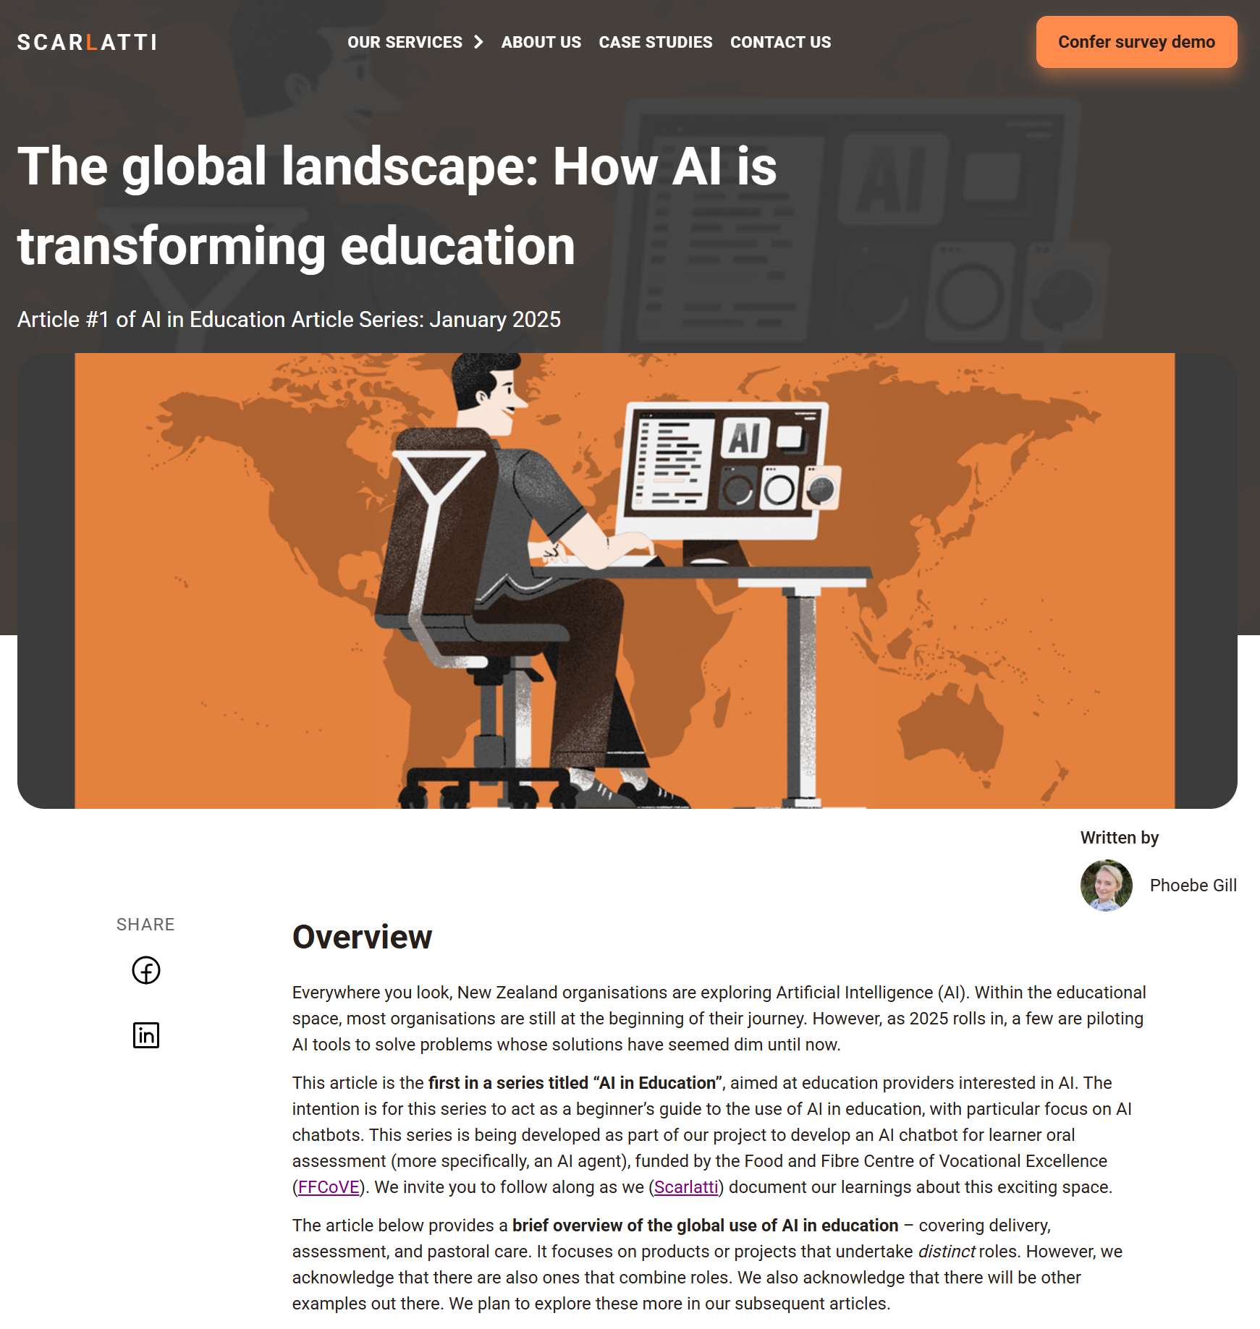
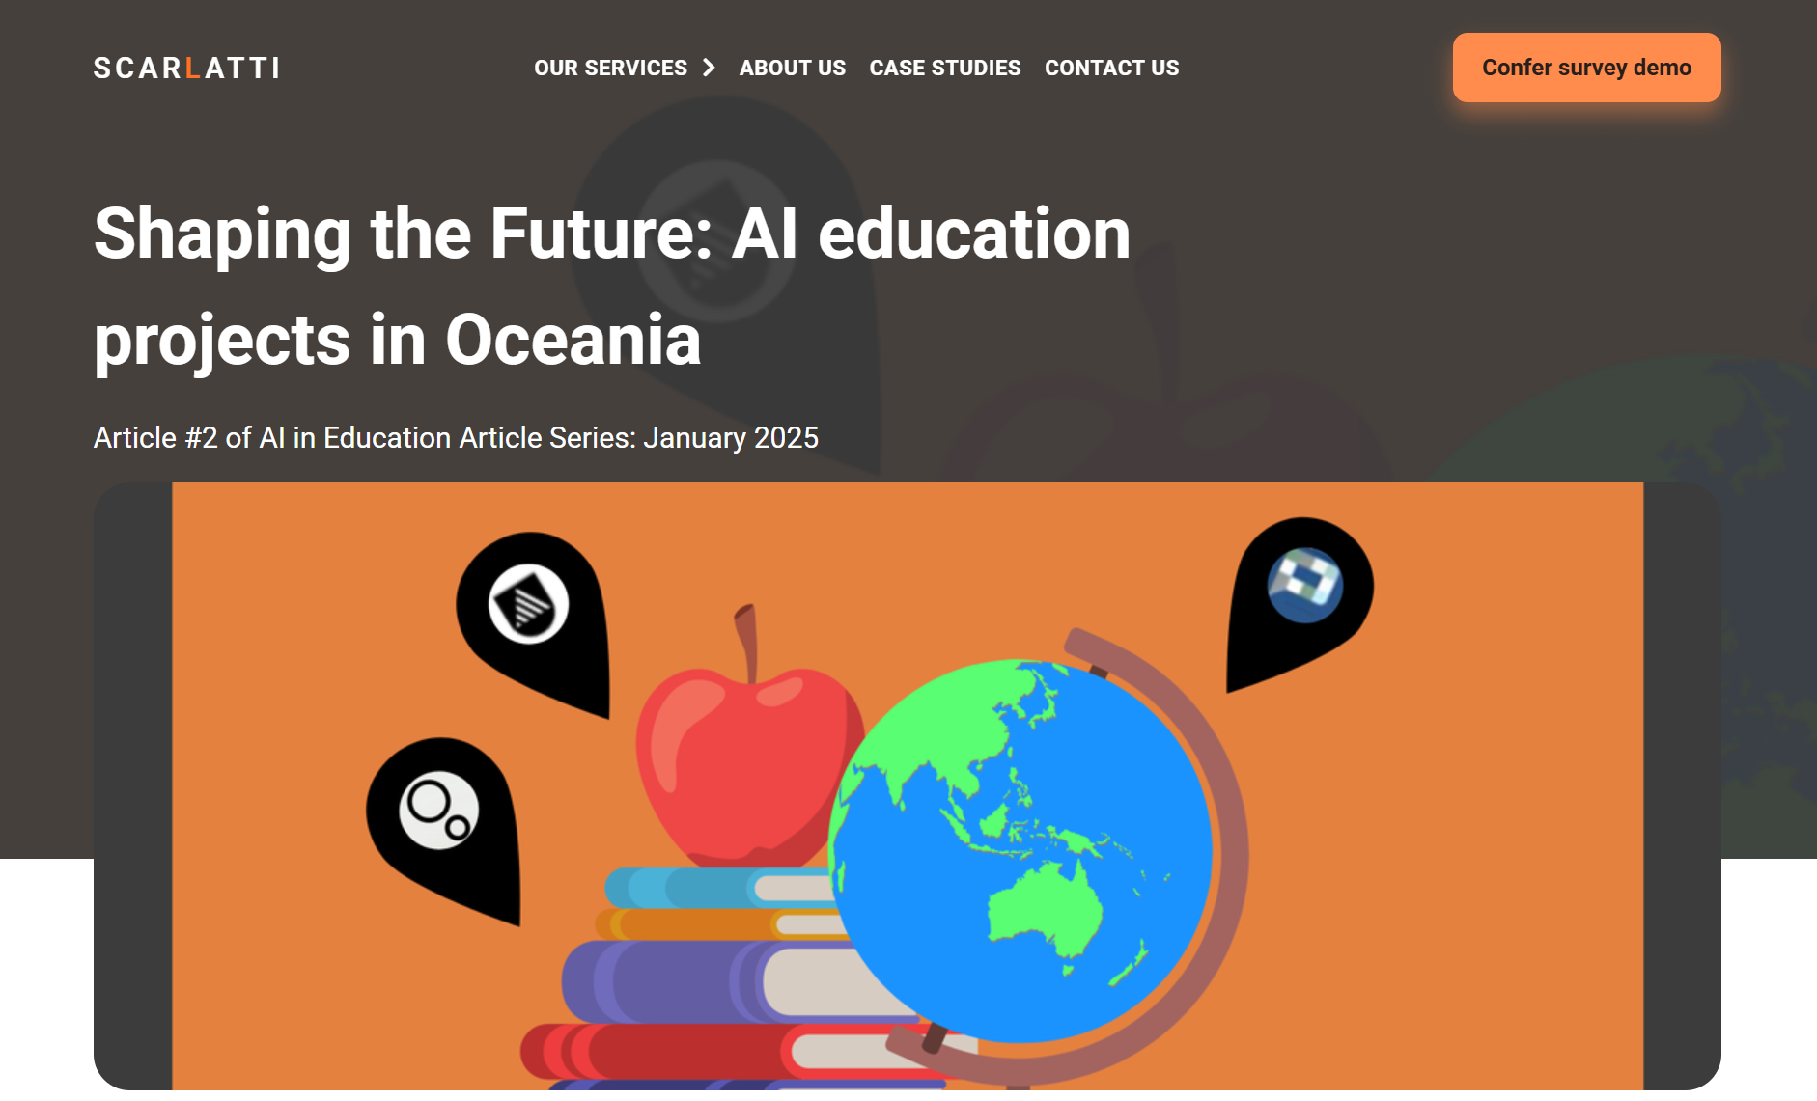
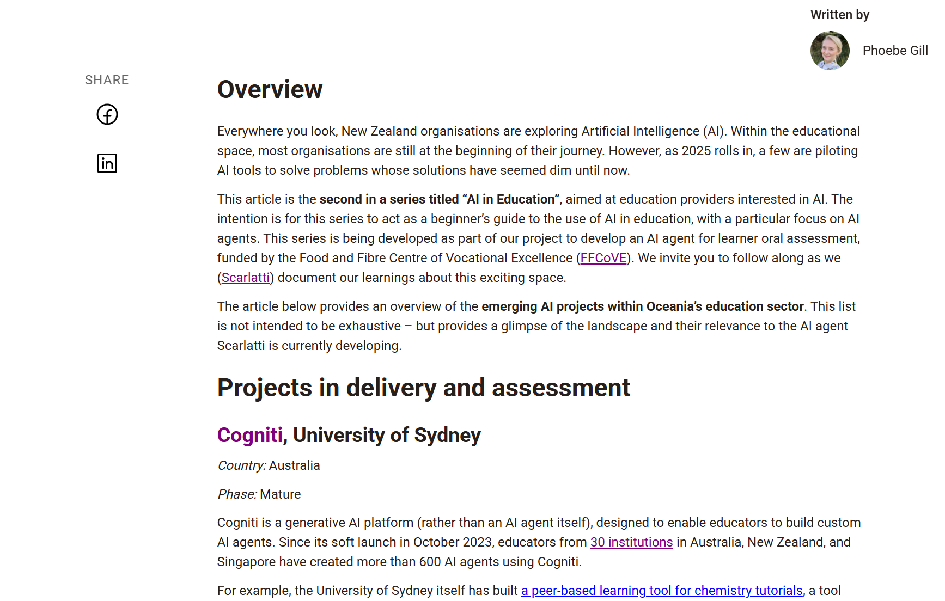
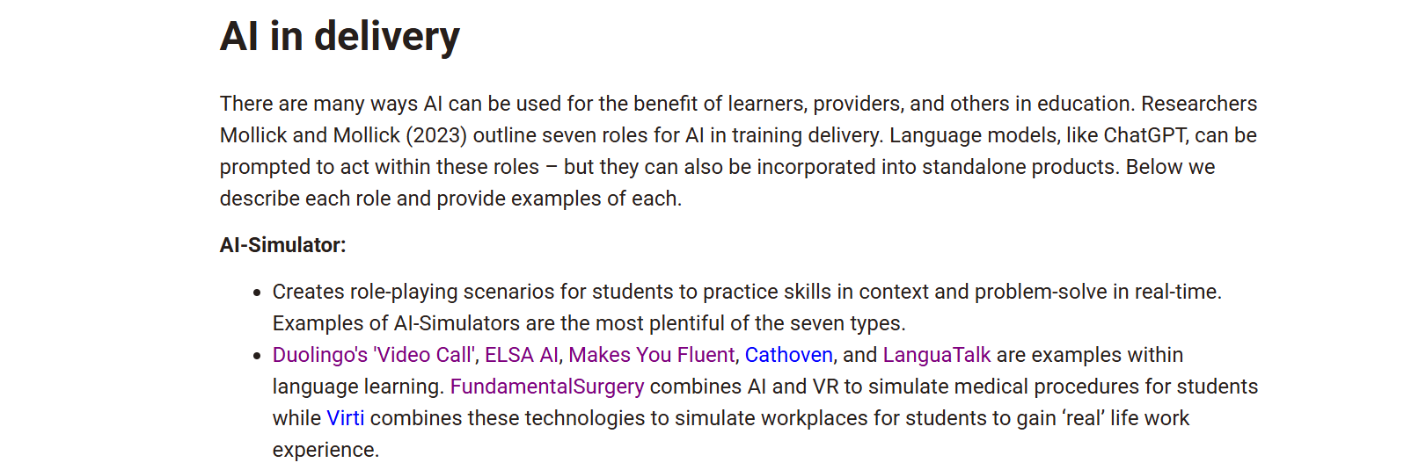
“AI in Education” articles

Slide 9
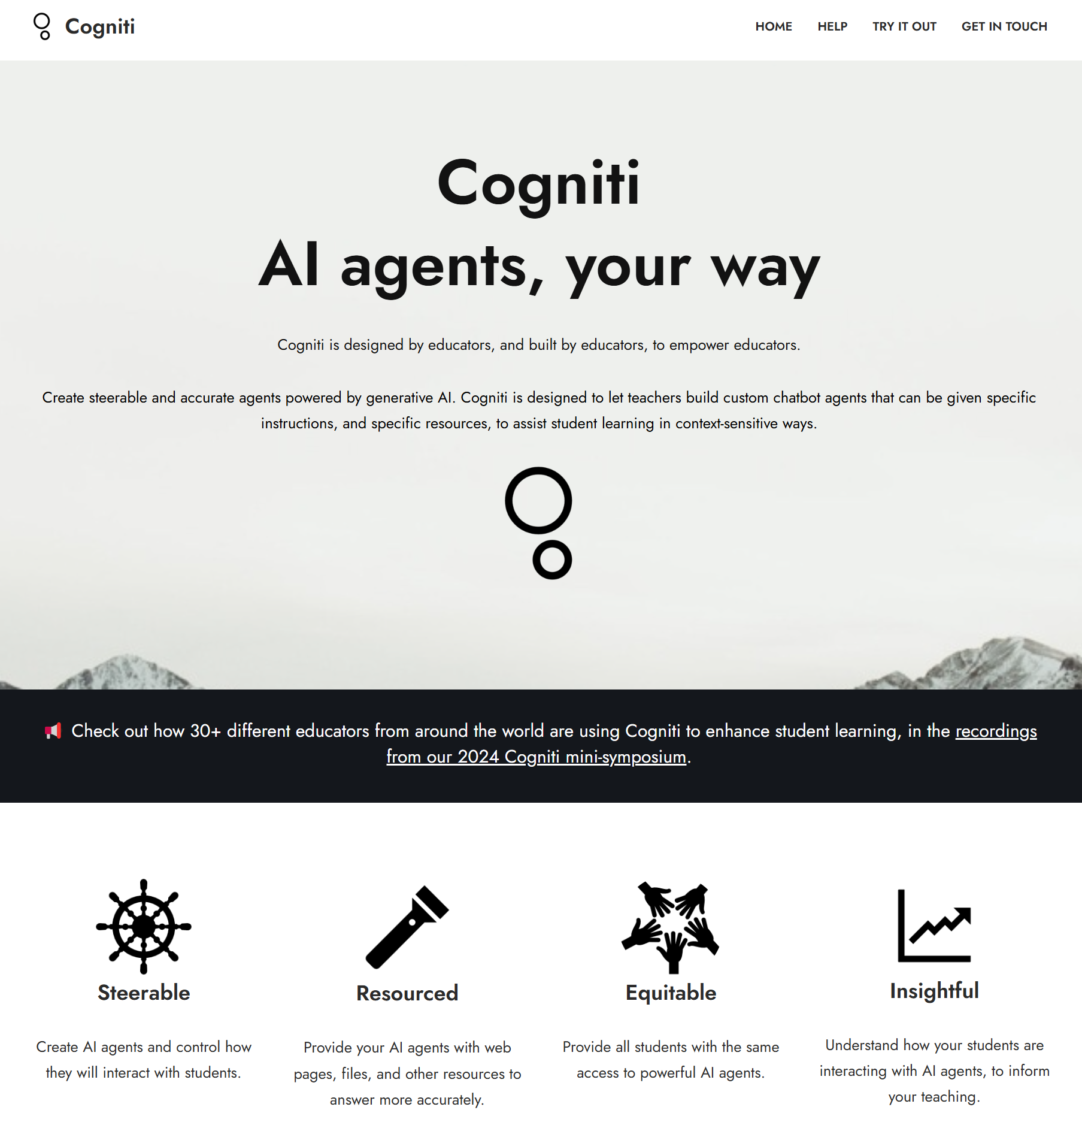
AI agents are flourishing in Oceania
These are typically…
Who: Universities
Location: Australia
Tool: Cogniti or GPTs
Mode: Text-based
Format: Q&A or role-play

Slide 10

Meanwhile, AI agents are flourishing in Oceania
It is harder to find…
Who: VET
Location: New Zealand
Tool: Custom-made or other platforms
Mode: Speech-based
Focus: Assessment

Slide 11










Some pioneers in New Zealand

Slide 12
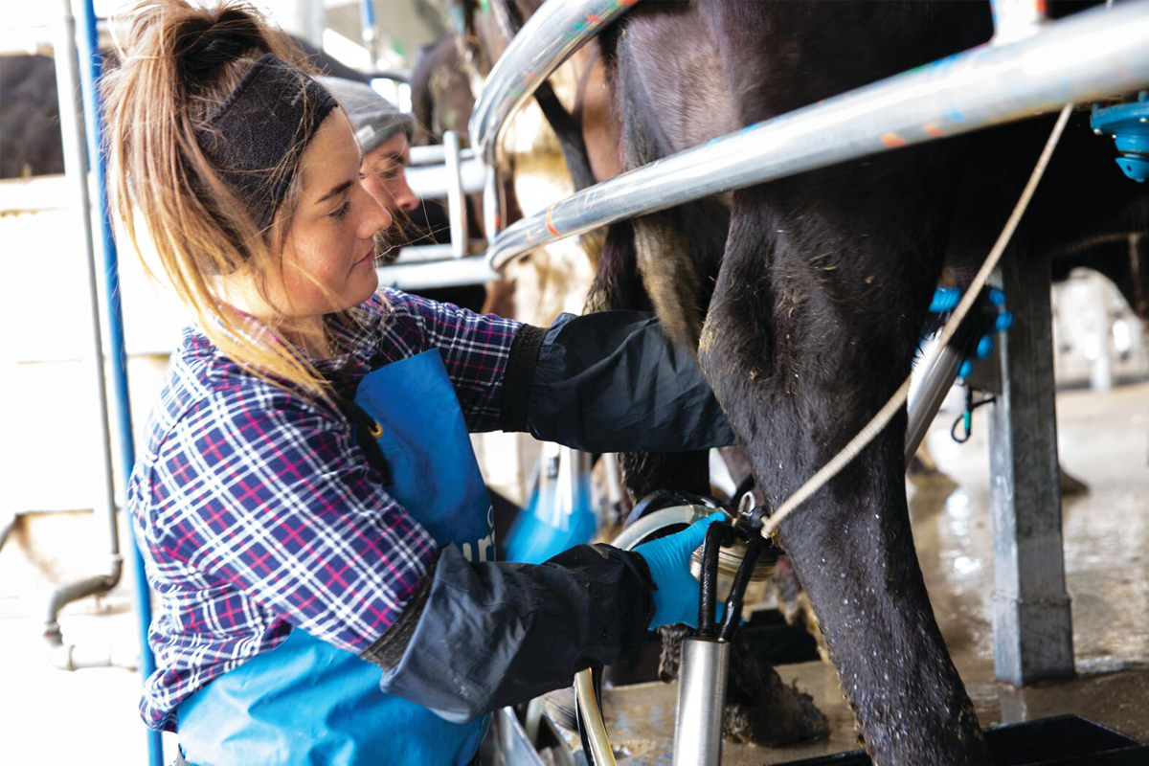


Demonstration
I am a new contract milker
This assessment is for contract milking 101 with Dairy Training Ltd. It will cover:
Typical contract issues
Guidelines for issues
Who to go to for help
This is a prototype

Slide 13


Demonstration
Tutor reviews outputs
Transcript
Provisional grade
Reason for grade
Audio recording.

Slide 14
Demonstration
It appears accurate
95% match between AI and human
Even tutors can disagree
Many non-matches are addressable.

Slide 15

How it works (current agent)
A custom agent
An off-the-shelf wouldn’t work for this:
  We need a controlled conversation
  We need precise outputs
  We want to charge the institute.

Slide 16


How it works (current agent)
.
.
A double agent
There are two agents used
We do this for specialisation and answer protection
Note: V2 has other models including text.
Examiner
(OpenAI Realtime Voice API)
Assessor
(GPT-4o text
model)

Slide 17
How it works (current agent)
Q1: What is a common contract issue…
Set assessment questions
The educator provides the questions
This controls the conversation.

Slide 18

How it works (current agent)
Assessment rubric
Exampleanswers & grades
Prompting content
Course materials
We give the agent information for it to decide how to respond/grade
This avoids it relying only on generic information from online

Slide 19

How it works (current agent)
‘RAG’
We use Retrieval Augmented Generation to search course information when needed
There is too much course information to put into the prompt.

Slide 20

How it works (work in progress)
Ethical guard rails
Protect learner data
Be transparent with users
Review outputs
Test for bias*
Based on a review of UNESCO's ethics of AI (2022); DIA’s public service AI framework (2025); Dr Karaitiana Taiuru's Te Tiriti-based AI ethical principles (2023); Office of the Privacy Commissioner advice (2023); MoE advice (2024); and joint work by the DIA, National Cyber Security Centre and Stats NZ (2023)

Slide 21

How it works (work in progress)
Misuse guard rails*
Preventative measures
Reactive measures

Slide 22

Pilots
Contract Milking 101 (Level 5)
Demographics
AI Agent
Provider:
Dairy Training Ltd
Format change:
Oral tutor to Oral AI
Aim:
Inclusive for remote and / or neurodiverse students and saves tutor time
11 students
Mixed ethnicities
Aged ~22 to ~40
Follow-up questions during
Feedback at the end

Slide 23
Pilots
Hei Whanaake H&S (Level 2)
Demographics
AI Agent
Provider:
Fruition
Format change:
Written to Oral AI
Aim:
Inclusive for young Māori learners, illiterate learners, and save tutor time
14 students
Predominantly Māori and Pasifika
Aged ~16
Follow-up question at the end
No feedback

Slide 24
Pilot findings
“Pretty straight forward” (Learner)
“Odd experience at first” (Learner)
“Very clear and understands you well” (Tutor)
It appears easy to use
20/25 said “easy” or “very easy”
Some technical challenges
To be fair, learning to use for first time
Some Fruition learners prefer writing.

Slide 25
Pilot findings
“You can do it anytime you want” (Learner)
“The instant feedback was great” (Learner)
“We need to talk to people… not computers” (Learner)
It appears quite enjoyable
15/24 said “enjoyable” or “very enjoyable”
Particularly appreciated instant feedback, flexible timing, ability to ask questions, & easier to talk than write
But still need human contact.

Slide 26
Pilot findings
It appears to empower
“Some of the students seemed upbeat after they’d done it… They were like, oh, this was really easy... It gave them confidence to not be afraid” (Fruition staff)
Seen most in Fruition learners
Ability to ask questions and not be judged, assessment felt easier/faster
Built belief in ability to do well.
“Most of our students have been let down by the education system and refuse to ask questions… But AI isn’t going to judge them. It empowers them”. (Fruition tutor)

Slide 27

Pilot findings
4 to 6 tutor hours saved per assessment
0 learner hours saved per assessment
It will likely save time
15 to 20 tutor hours saved per assessment
28 to 33 learner hours saved per assessment
Note that Dairy Training’s hours saved are less given they shifted from a tutor-run oral assessment to an AI-run oral assessment. Fruition shifted from a written assessment to an AI-run oral assessment.

Slide 28
Pilot findings
“I prefer writing, just personal preference’ (Learner)
Do learners want to see more of it?
21/24 either interested to see more of it OR open to it with improvements
Technical fixes and showing learners how to use it will help
But – also evidence that some learners still prefer writing.

Slide 29






How could oral AI be used in learning & assessment?
Summative
Formative
Authentication
Employer verification
Pre-screening
RPL

Slide 30

Where to next?

Slide 31
Question and answer panel
Adam Barker
Scarlatti
Sam Cormack
Scarlatti
Lester Hoare
Muka Tangata
Jenny Sinclair
Dairy Training
Tiffany Andrews
Fruition

Slide 32
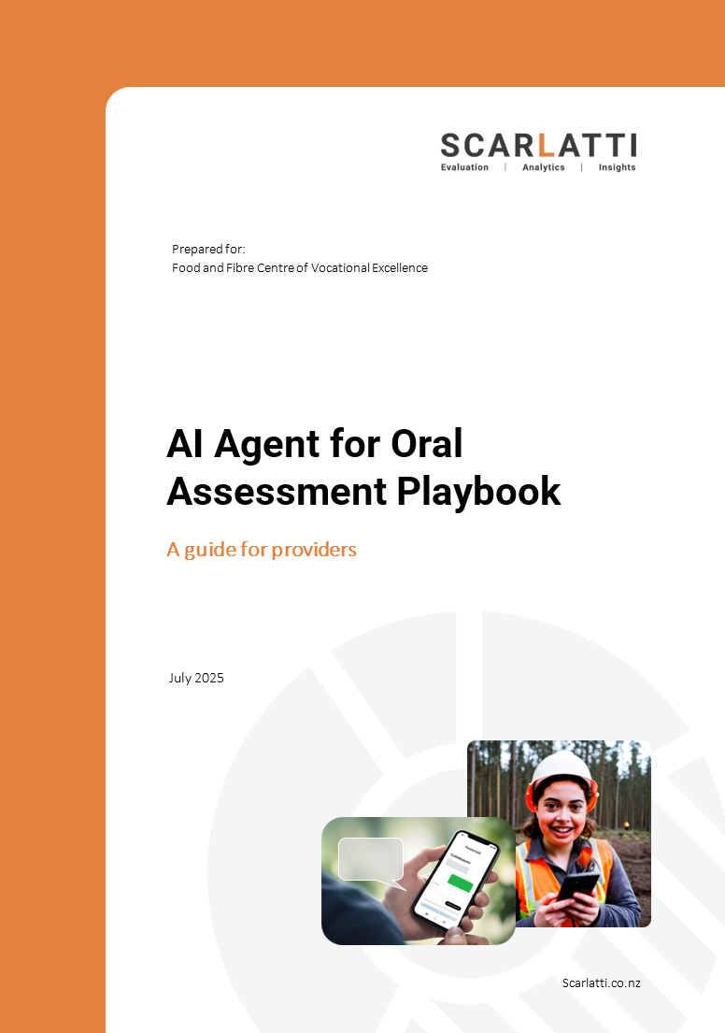
Thanks for your time
Scarlatti will send links to the recording, playbook, and newsletters

Slide 33
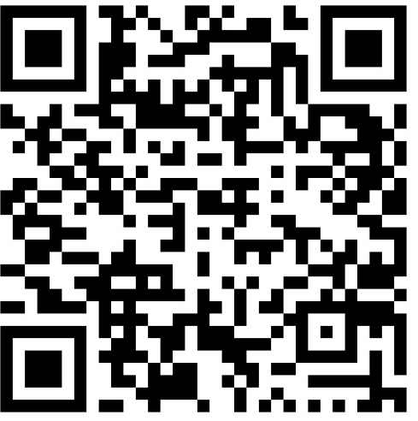

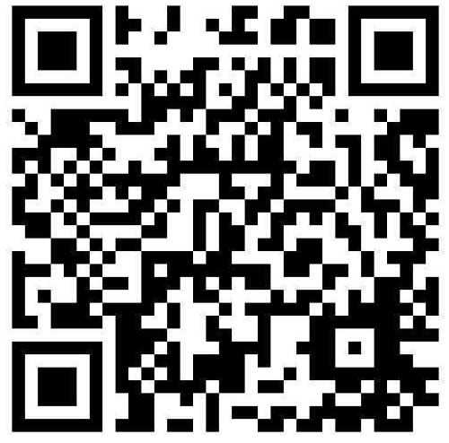
Feel free to get in touch
Phoebe Gill
Scarlatti
phoebe.gill@scarlatti.co.nz
Adam Barker
Scarlatti
adam.barker@scarlatti.co.nz

